Slide 1
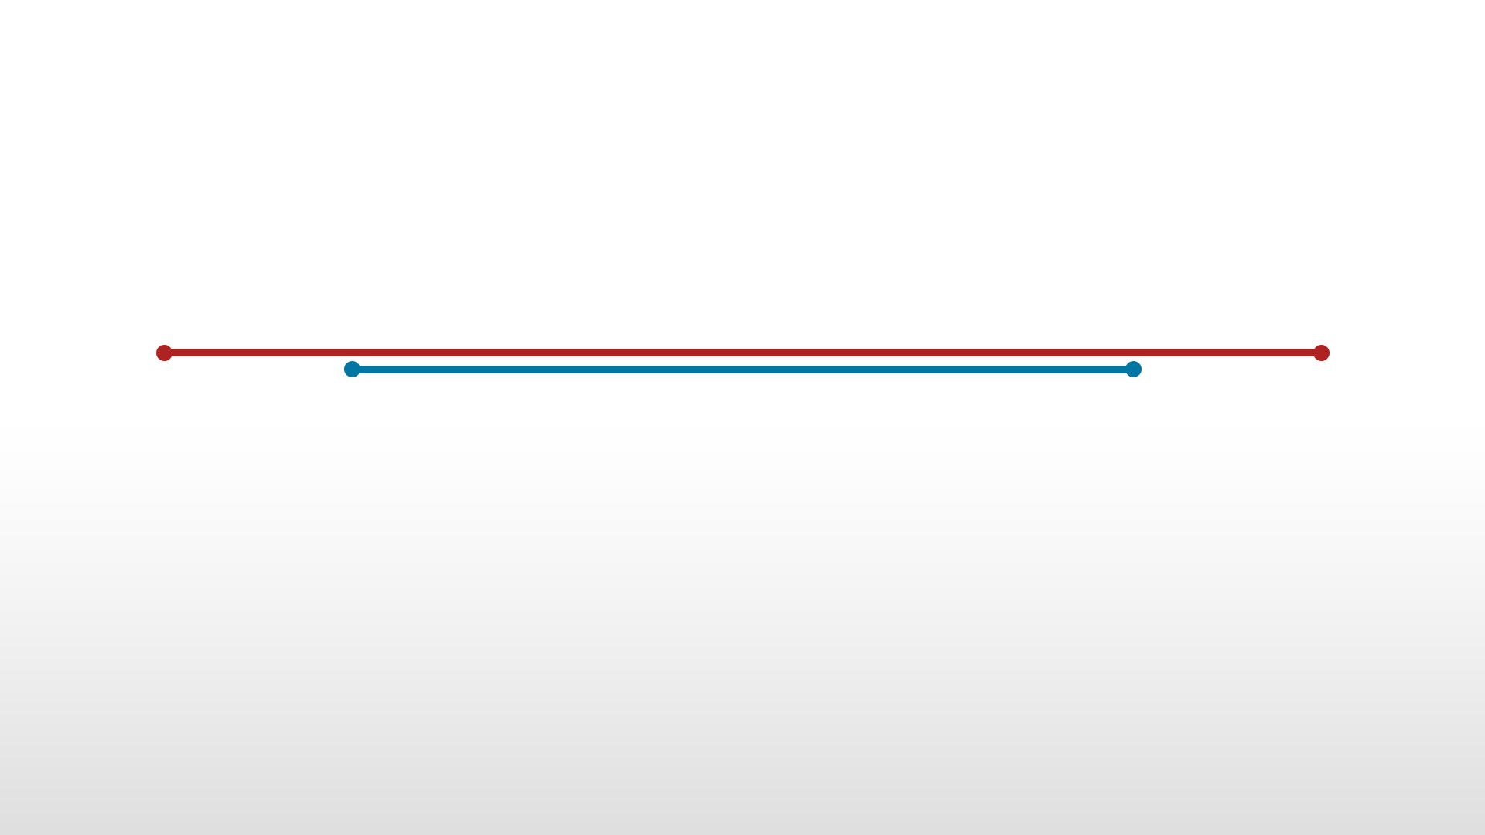
CZ2001 – ALGORITHMS – EXAMPLE CLASS 3A
Group 3
Tan Wei Xuan
Datta Anusha
Prashant Mohit
Han Jun
Wang Yifan
Ho Shu Peng Xavier
Kumar Mehul

Slide 2
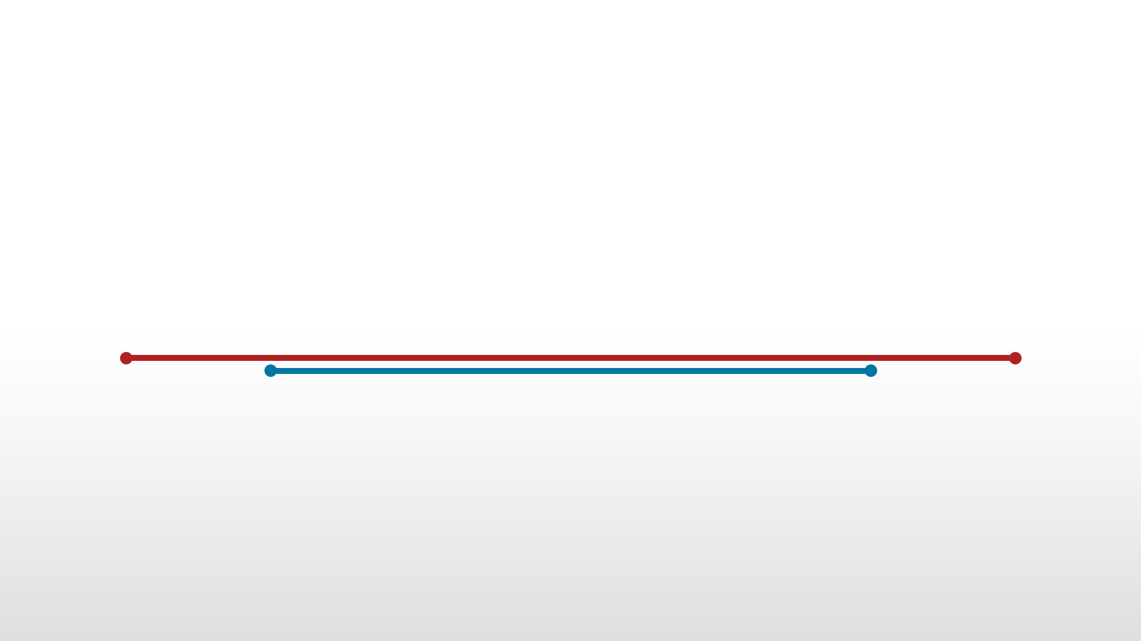
PROBLEM DOMAIN

Slide 3

PROBLEM DOMAIN
Showing the empirical comparison of time efficiency for Insertion Sort and Merge Sort
for this example class, we will be performing the two sorting algorithms on:
Data set sizes ranging from 100 to 10000, with a step size of 100

Slide 4
PROBLEM DOMAIN
Showing the empirical comparison of time efficiency for Insertion Sort and Merge Sort
for this example class, we will be performing the two sorting algorithms on three types of data:
Integers 1,2, …, n sorted in ascending order
Integers n, n-1, …, 1 sorted in descending order
Randomly generated datasets of Integers in the range [1 … n]
INTRODUCTION • IMPLEMENTATION • STATISTICS • CONCLUSION

Slide 5
Generating Data Sets

Slide 6
Ascending List
Integers 1,2, …, n sorted in ascending order

Slide 7
Ascending List
def generateArraysIncSize():
#List (Parent) to store all the data sets of different sizes
bigList = []
# Generate Data Set Size from 100 to 10000, with a step size of 100
for n in range(100 , 10001, 100):
# Generate Integers from 1,2, ..., n in ascending order)
# Store each list(child) in a list(parent)
bigList.append(list(range(1, n+1)))
return bigList
#Generate the Ascending List
ascList = generateArraysIncSize()

Slide 8
Descending List
Integers n, n-1, … , 1 sorted in descending order

Slide 9
Descending List
#Reversing the data within each data set size using the list that we generated with generateArraysIncSize()
def reverseList(bigList):
#List (Parent) to store all the data sets of different sizes
descList = []
#For each list generated with generateArraysIncSize()
for li in bigList:
# Reverse the elements for within the an array (n , n-1, ..., 1)
descList.append(li[::-1])
return descList
#Generate the Descending List
descList = reverseList(generateArraysIncSize())

Slide 10
Random List
Randomly generated datasets of Integers in the range [1 … n]

Slide 11
Random List
#Generate random data (with repeats) for each data size
def generateRandom():
#List (Parent) to store all the data sets of different sizes
bigList = []
# Generate Data Set Size from 100 to 10000, with a step size of 100
for n in range(100 , 10001, 100):
#Generate a list of n size selected from the range 1 to n, with duplicates
# Store each list (child) in a list (parent)
bigList.append([random.choice(range(1,n+1)) for i in range(n)])
return bigList
#Generating the Randomly-Ordered List
randList = generateRandom()

Slide 12
IMPLEMENTATION

Slide 13
IMPLEMENTATION
Insertion Sort
Merge Sort

Slide 14
Insertion Sort

Slide 15
Insertion Sort
The Insertion Sort algorithm takes elements from the input array and places those elements in their correct place into a new array, shifting existing array elements as needed.

Slide 16
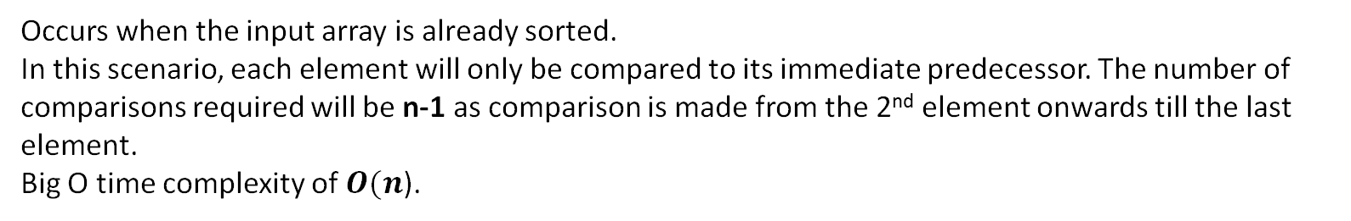
Insertion Sort
The Insertion Sort algorithm takes elements from the input array and places those elements in their correct place into a new array, shifting existing array elements as needed.
Best Case:
Occurs when the input array is already sorted. In this scenario, each element will only be compared to its immediate predecessor. The number of comparisons required will be n-1 as comparison is made from the 2nd element onwards till the last element. Big O time complexity of$O(n$).

Slide 17
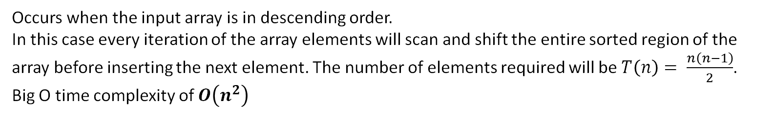
Insertion Sort
The Insertion Sort algorithm takes elements from the input array and places those elements in their correct place into a new array, shifting existing array elements as needed.
Worst Case:
Occurs when the input array is in descending order.
In this case every iteration of the array elements will scan and shift the entire sorted region of the array before inserting the next element. The number of elements required will be $T\left(n\right)= \frac{n\left(n−1\right)}{2}$.
Big O time complexity of $O\left(n^{2}\right)$
INTRODUCTION • IMPLEMENTATION • STATISTICS • CONCLUSION

Slide 18
Insertion Sort
def insertionSort(list):
#Number of Comparisons
numOfComp = 0
# Traverse through 1 to N (Length of Array)
for i in range(1,len(list)):
#Key Value
value = list[i]
#Index to compare key with
j = i - 1
# Move elements of arr[0..i-1], that are
# greater than key, to one position ahead
# of their current position or till index reaches the front of the array
while j>=0:
#Increase the number of key Comparisons
numOfComp = numOfComp + 1
#Key is smaller than the Element of the array
if value<list[j]:
flag=True
#Key is greater than or equal to the Element of the array
else :
flag=False
#Swap the position of the Key and the Element of the array
if flag:
list[j+1] = list[j]
list[j] = value
j = j - 1
#Exit if Key is greater than the Element of the Array
else:
break
return numOfComp

Slide 19
STATISTICS (Insertion Sort)
Insertion Sort

Slide 20
Merge Sort

Slide 21
Merge Sort
The Merge Sort algorithm is a divide-and-conquer algorithm. It takes input of an array and recursively divides that array into sub arrays of single elements. A single element is already sorted, and so the elements are sorted back into sorted arrays, two sub-arrays at a time, until we are left with a final sorted array.

Slide 22
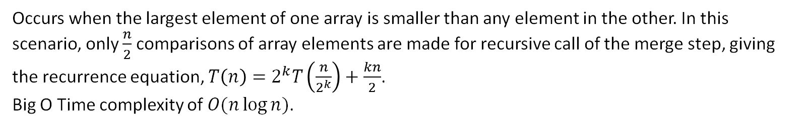
Merge Sort
The Merge Sort algorithm is a divide-and-conquer algorithm. It takes input of an array and recursively divides that array into sub arrays of single elements. A single element is already sorted, and so the elements are sorted back into sorted arrays, two sub-arrays at a time, until we are left with a final sorted array.
Best Case:
Occurs when the largest element of one array is smaller than any element in the other. In this scenario, only ­$\frac{n}{2}$ comparisons of array elements are made for recursive call of the merge step, giving the recurrence equation, $T\left(n\right)=2^{k}T\left(\frac{n}{2^{k}}\right)+\frac{kn}{2}$. Big O Time complexity of $O(n\log{n})$.

Slide 23
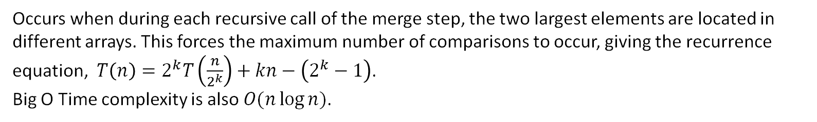
Merge Sort
The Merge Sort algorithm is a divide-and-conquer algorithm. It takes input of an array and divides that array into sub arrays of single elements. A single element is already sorted, and so the elements are sorted back into sorted arrays, two sub-arrays at a time, until we are left with a final sorted array.
Worst Case:
Occurs when during each recursive call of the merge step, the two largest elements are located in different arrays. This forces the maximum number of comparisons to occur, giving the recurrence equation, $T\left(n\right)=2^{k}T\left(\frac{n}{2^{k}}\right)+kn−\left(2^{k}−1\right)$.
Big O Time complexity is also $O(n\log{n})$.

Slide 24
#Number of Comparisons
compCounter = 0
def mergeSort(input_list):
global compCounter
#Split the array into two halves recursively until they are all within a single array element. if len(input_list)>1:
mid = len(input_list)//2
lefthalf = input_list[:mid]
righthalf = input_list[mid:]
mergeSort(lefthalf)
mergeSort(righthalf)
i = j = k = 0
#Merging the splitted arrays recursively.
#While there are still elements in the left and right array
#Copy values from the left & right array (in order) into the sorted array
while i < len(lefthalf) and j < len(righthalf):
#Key Comparison
compCounter += 1
#If value in left half is smaller then value in right half
#Copy value from left half into sorted array
if lefthalf[i] < righthalf[j]:
input_list[k]=lefthalf[i]
i=i+1
#If value in right half is smaller then value in left half
#Copy value from right half into sorted array
elif lefthalf[i] > righthalf[j]:
input_list[k]=righthalf[j]
j=j+1
#If value in left half is equal to value in right half
#Copy values from left and right halves into sorted array
else:
input_list[k]=righthalf[j]
k = k+1
input_list[k]=lefthalf[i]
i=i+1
j=j+1
#Increase the current index of the sorted array
k=k+1

Slide 25
#Number of Comparisons
compCounter = 0
def mergeSort(input_list):
global compCounter
#Split the array into two halves recursively until they are all within a single array element. if len(input_list)>1:
mid = len(input_list)//2
lefthalf = input_list[:mid]
righthalf = input_list[mid:]
mergeSort(lefthalf)
mergeSort(righthalf)
i = j = k = 0
#Merging the splitted arrays recursively.
#While there are still elements in the left and right array
#Copy values from the left & right array (in order) into the sorted array
while i < len(lefthalf) and j < len(righthalf):
…
#When one list becomes empty, copy all values from the remaining array into the sorted array
#While there are still elements in the left array only (right array completely merged) : No Comparisons here
while i < len(lefthalf):
input_list[k]=lefthalf[i]
i=i+1
k=k+1
#While there are still elements in the right array only (left array is completely merged) : No Comparisons here
while j < len(righthalf):
input_list[k]=righthalf[j]
j=j+1
k=k+1

Slide 26
STATISTICS (Merge Sort)
Merge Sort

Slide 27
Graphs & Empirical Analysis

